Slide 1
Breaking the Curse of Horizon: Infinite-Horizon Off-Policy Estimation
Speaker: Narsil Zhang

Slide 2



Task
off-policy estimation of the expected reward of a target policy
using samples collected by a different policy

Slide 3




A Traditional Way: Importance Sampling
from another policy $π_{0}$ to estimate $π$’s reward (until time $T$):

Slide 4

Con of Importance Sampling
variance grows exponentially with $T$ (?)
proof in appendix

Slide 5
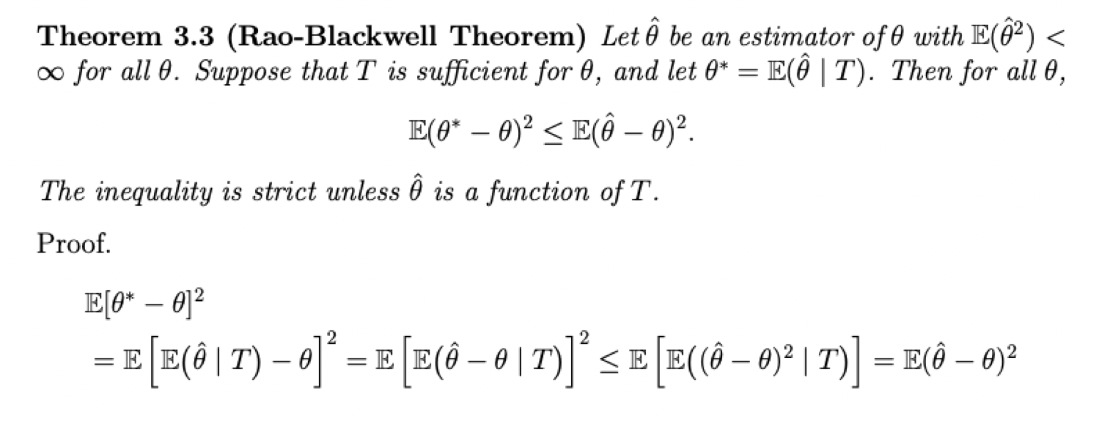
Rao-Blackwell: Reducing Variance

Slide 6

Recall we use for trajectory-wise estimation
By Rao-Blackwell, we can use instead, which is called step-wise estimation

Slide 7



Or, we can define
later we will define $d_{π}(s)$
then we have a new way: （*）
this will be justified later, too~

Slide 8
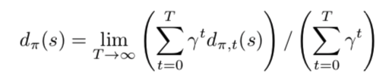

To justify (*) ...
firstly, define average visitation distribution $d_{π}(s)$:
which means the average visitation distribution for state $s$

Slide 9

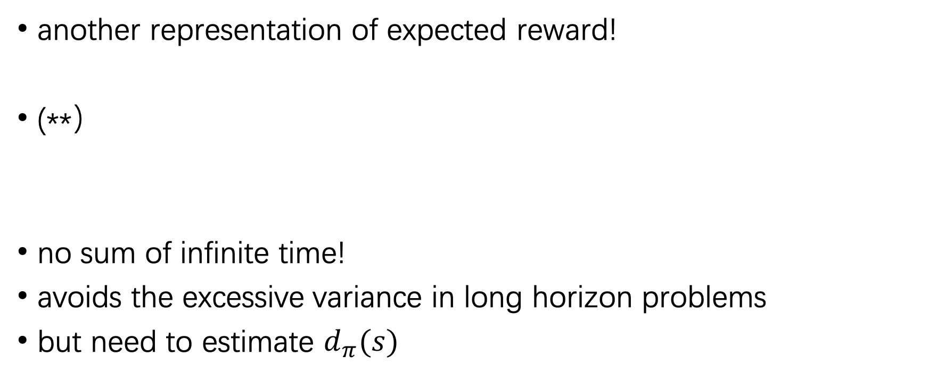
Then we have...
another representation of expected reward!
(**）
no sum of infinite time!
avoids the excessive variance in long horizon problems
but need to estimate $d_{π}(s)$

Slide 10
An Intuitive Proof

Slide 11




How to estimate (**) when off-policy?
Still, importance sampling:
this is (*) !

Slide 12
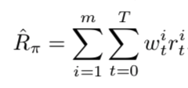
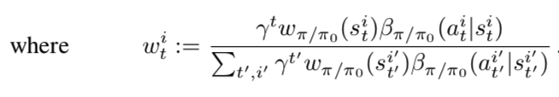
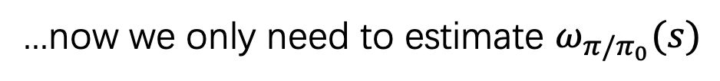
which is estimated by...
...now we only need to estimate $ω_{π/π_{0}}(s)$

Slide 13


Luckily we have a theorem: (some details omitted)
we can show that for arbitrary $ω$:
where

Slide 14



Thus, finding $ω$ is equivalent to...
solving an optimization problem:
with a pre-chosen function space
we take to be a Hilbert kernel unit ball, which is a subset of reproducing kernel Hilbert space (RKHS), due to its elegant properties

Slide 15

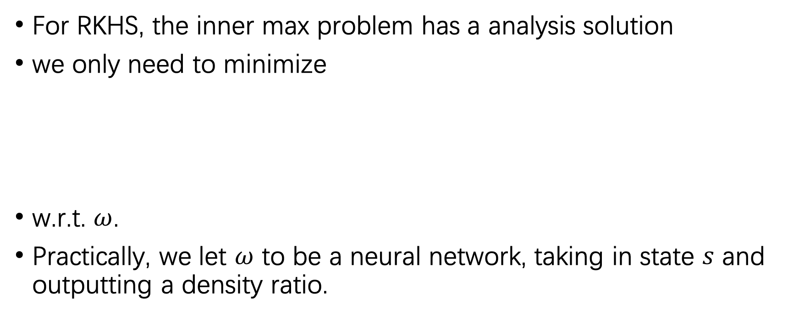
For RKHS, the inner max problem has a analysis solution
we only need to minimize
w.r.t. $ω$.
Practically, we let $ω$ to be a neural network, taking in state $s$ and outputting a density ratio.

Slide 16
Thank you!

